Slide 1

A Survey of Neural Radiance Fields and Gaussian Splatting in Satellite Remote Sensing
Presentation by
Konark Karia [AU2544011]
Megh Patel [AU2544020]
Hardi Makwana [AU2544013]
School of Engineering and Applied Science, Ahmedabad University

Slide 2
Motivation
Traditional 3D mapping often fails on satellite-specific textures, reflections, and deep shadows where neural methods excel.
NeRFs provide a continuous neural representation that "fills in the gaps" to create photorealistic 3D geometry from 2D pixels.
3D Gaussian Splatting provides the critical leap from slow neural training to real-time, high-speed rendering of satellite scenes.
Konark Karia | Megh Patel | Hardi Makwana

Slide 3
Motivation
Modern neural models can uniquely separate permanent terrain geometry from transient atmospheric haze and shifting sun angles.
These technologies enable the leap from modeling single structures to generating interactive, city-scale "Digital Twins" of the Earth.
This survey categorizes a rapidly expanding field to help researchers select the most efficient architectures for remote sensing.
Konark Karia | Megh Patel | Hardi Makwana

Slide 4
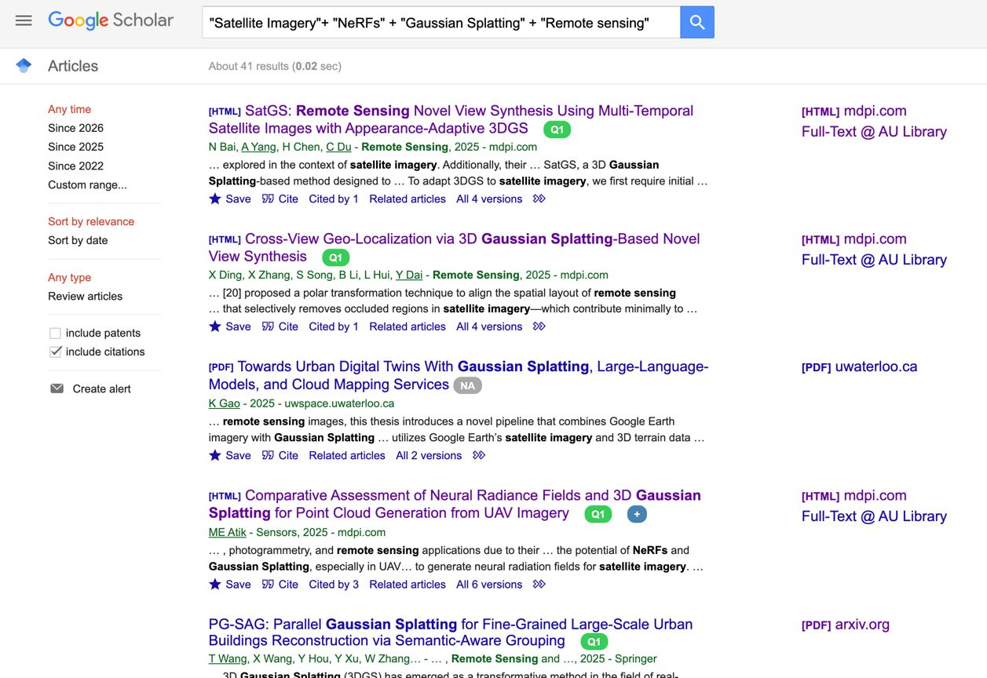
Search Results
Total Results Found : 41
Average Citations : ~1.5
Keywords used:
Satellite Imagery
NeRFs
Gaussian Splatting
Remote Sensing
Konark Karia | Megh Patel | Hardi Makwana

Slide 5
Research Paper
Our Current Survey is being carried on the following papers:
Ortho-NeRF: generating a true digital orthophoto map using the neural radiance field from unmanned aerial vehicle images [Taylor & Francis (under Informa UK Limited, trading as Taylor & Francis Group) 2024] [Q1] : Noise Correction in Drone Images and Improvements in NeRF, and correction of Sheared Images.
Cross-View Geo-Localization via 3D Gaussian Splatting-Based Novel View Synthesis [Remote Sensing, MDPI 2025] [Q1] : Enhancing Cross View Geolocalization using 3D Gaussian Splatting based Novel View Synthesis.
Konark Karia | Megh Patel | Hardi Makwana

Slide 6
Research Paper
Our Current Survey is being carried on the following papers:
SatGS: Remote Sensing Novel View Synthesis Using Multi- Temporal Satellite Images with Appearance-Adaptive 3DGS [Remote Sensing, MDPI 2025] [Q1] : SatGS improves 3D satellite mapping by automatically fixing seasonal color changes, accurately placing shadows based on the sun's position, and 'erasing' moving objects like cars, making it faster and clearer than previous methods.
Konark Karia | Megh Patel | Hardi Makwana

